Slide 1
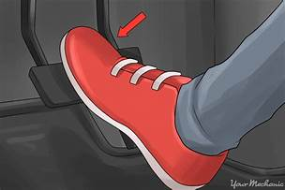
Abstract Class
Notes:
Title + Bullets
No more than 4 points. Please use another similar slide incase you have more points.

Slide 2
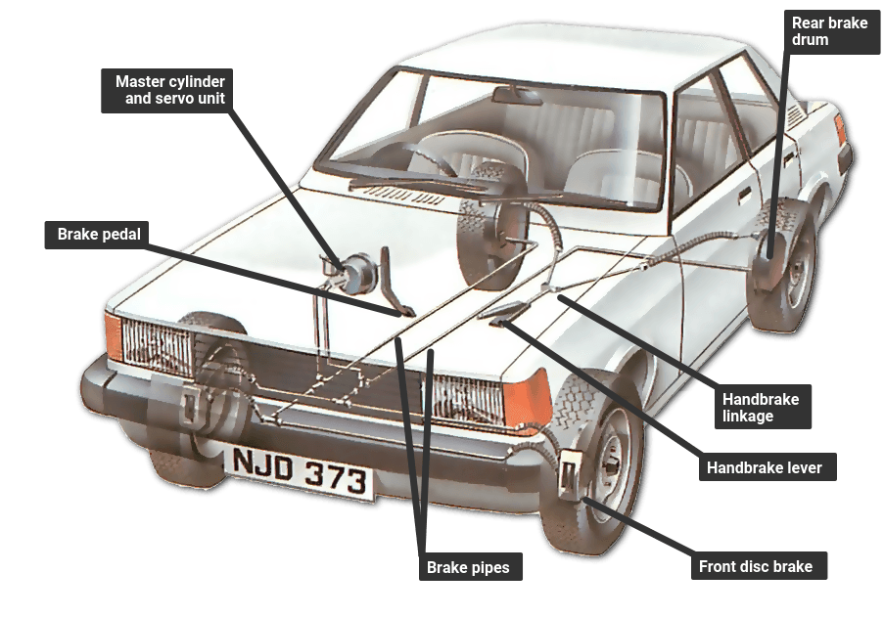
Abstract Class
Considered as a blueprint for other classes
Contains one or more abstract class
Created within any child classes
method that has declaration but not has any implementation
Notes:
Title + Bullets
No more than 4 points. Please use another similar slide incase you have more points.

Slide 3
Syntax
From abc import ABC
Class className(ABC):
Notes:
To consider any class as an abstract class, the class has to inherit ABC metaclass from the python built-in abc module. abc module imports the ABC metaclass.

Slide 4
Why Abstract Class
Provide default functionality for the subclasses
Used to define a common Application Program Interface(API) for a set of subclasses
Helpful in large code as remembering many classes is difficult.
Notes:
Title + Bullets
No more than 4 points. Please use another similar slide incase you have more points.

Slide 5
How it works
Considered as a blueprint for other classes
Contains one or more abstract class
Created within any child classes
method that has declaration but not has any implementation
Notes:
Title + Bullets
No more than 4 points. Please use another similar slide incase you have more points.

Slide 6
Abstract Class
Cant create object
Inherit Abstract class
Create object
Notes:
Blank slide (Text Only)
Use this slide as an extension of other slides. Therefore, if the data doesn’t fit in any of the slides then put the extra data here.

Slide 7
Abstract Methods
Methods that are declared without any implementations
SYNTAX:
from abc import ABC, abstract method
Class className(ABC):
@abstractmethod
def mymethod(self):
#empty body
pass
Notes:
To define the abstract methods in an abstract class, the method must be decorated with a keyword called @abstractmethod decorator. The @abstractmethod decorator has to be imported from the python built-in library called abc.

Slide 8
// Predict the output
from abc import ABC, abstractmethod
class AbstractClass(ABC):
@abstractmethod
def Example(self):
print("Some one is there")
class AnotherClass(AbstractClass):
def Example(self):
super().Example()
print("calling the AnotherClass")
x = AnotherClass()
x.Example()
1
2
3
4
5
6
7
8
9
10
11
12
13
14
15
16
17
18
19
20
21
22

Slide 9
OUTPUT
Some one is there
calling the AnotherClass
Notes:
Output

Slide 10
Abstract Properties
Properties along with abstract methods defined by @abstractproperty
We can now use property.getter(), property.setter() and property.deleter() with abstract classes

Slide 11
Syntax
class class_name(ABC):
@property
@abstractmethod
Def method(self):

Slide 12
import abc
from abc import ABC, abstractmethod
class parent(ABC):
@abc.abstractproperty
def geeks(self):
return "parent class"
class child(parent):
@property
def geeks(self):
return "child class"
try:
r =parent()
print( r.geeks)
except Exception as err:
print (err)
r = child()
print (r.geeks)
1
2
3
4
5
6
7
8
9
10
11
12
13
14
15
16
17
18
19
20
21
22

Slide 13
OUTPUT
Can't instantiate abstract class parent with abstract methods geeks
child class
Notes:
Output

Slide 14
Abstract class Instantiation
Abstract classes are incomplete because they have methods which have no body.
We use abstract class as a template and according to the need we extend it and build on it before we can use it.
An abstract class is not a concrete class, it cannot be instantiated.
When we create an object for the abstract class it raises an error.

Slide 15
from abc import ABC,abstractmethod
class Animal(ABC):
@abstractmethod
def move(self):
pass
class Human(Animal):
def move(self):
print("I can walk and run")
class Snake(Animal):
def move(self):
print("I can crawl")
class Dog(Animal):
def move(self):
print("I can bark")
class Lion(Animal):
def move(self):
print("I can roar")
a = Animal()
d = Dog()
d.move()
c=Animal()
1
2
3
4
5
6
7
8
9
10
11
12
13
14
15
16
17
18
19
20
21
22

Slide 16
OUTPUT
Traceback (most recent call last):
File "/home/ffe4267d930f204512b7f501bb1bc489.py", line 19, in
c=Animal()
TypeError: Can't instantiate abstract class Animal with abstract methods move
Notes:
Output

Slide 17
Question 1
Which among the following best defines abstraction?
A)
Hiding the implementation
B)
Showing the important data
C)
Hiding the important data
D)
Hiding the implementation and showing only the features
Notes:
Ans : Option D

Slide 18
Question 2
Class is _________ abstraction.
A)
Object
B)
Logical
C)
Real
D)
Hypothetical
Notes:
Ans : Option B

Slide 19
Question 3
How abstraction is achieved in python ?
A)
Abstract classes
B)
Interfaces.
C)
Overriding
D)
Both a & b
Notes:
Ans : Option D

Slide 20
Question 4
Can abstract class have main() function defined inside it?
A)
Yes, depending on return type of main()
B)
Yes, always
C)
No, main must not be defined inside abstract class
D)
No, because main() is not abstract function
Notes:
Ans : Option b
Explanation: This is a property of abstract class. It can define main() function inside it. There is no restriction on its definition and implementation.

Slide 21
Question 5
If there is an abstract method in a class then, _____________
A)
Class must be abstract class
B)
Class may or may not be abstract class
C)
Class is generic
D)
Class must be public
Notes:
Ans : Option a
Explanation: It is a rule that if a class have even one abstract method, it must be an abstract class. If this rule was not made, the abstract methods would have got skipped to get defined in some places which are undesirable with the idea of abstract class.

Slide 22
Question 6
Abstract classes can ______________ instances
A)
Never have
B)
Always have
C)
Have array of
D)
Have pointer of
Notes:
Ans : Option a
Explanation: When an abstract class is defined, it won’t be having the implementation of at least one function. This will restrict the class to have any constructor. When the class doesn’t have constructor, there won’t be any instance of that class.

Slide 23
Question 7
Is it necessary that all the abstract methods must be defined from an abstract class?
A)
Yes, depending on code
B)
Yes, always
C)
No, never
D)
No, if function is not used, no definition is required.
Notes:
Ans : Option b
Explanation: That is the rule of programming language that each function declared, must have some definition. There can’t be some abstract method that remains undefined. Even if it’s there, it would result in compile time error.

